Slide 1
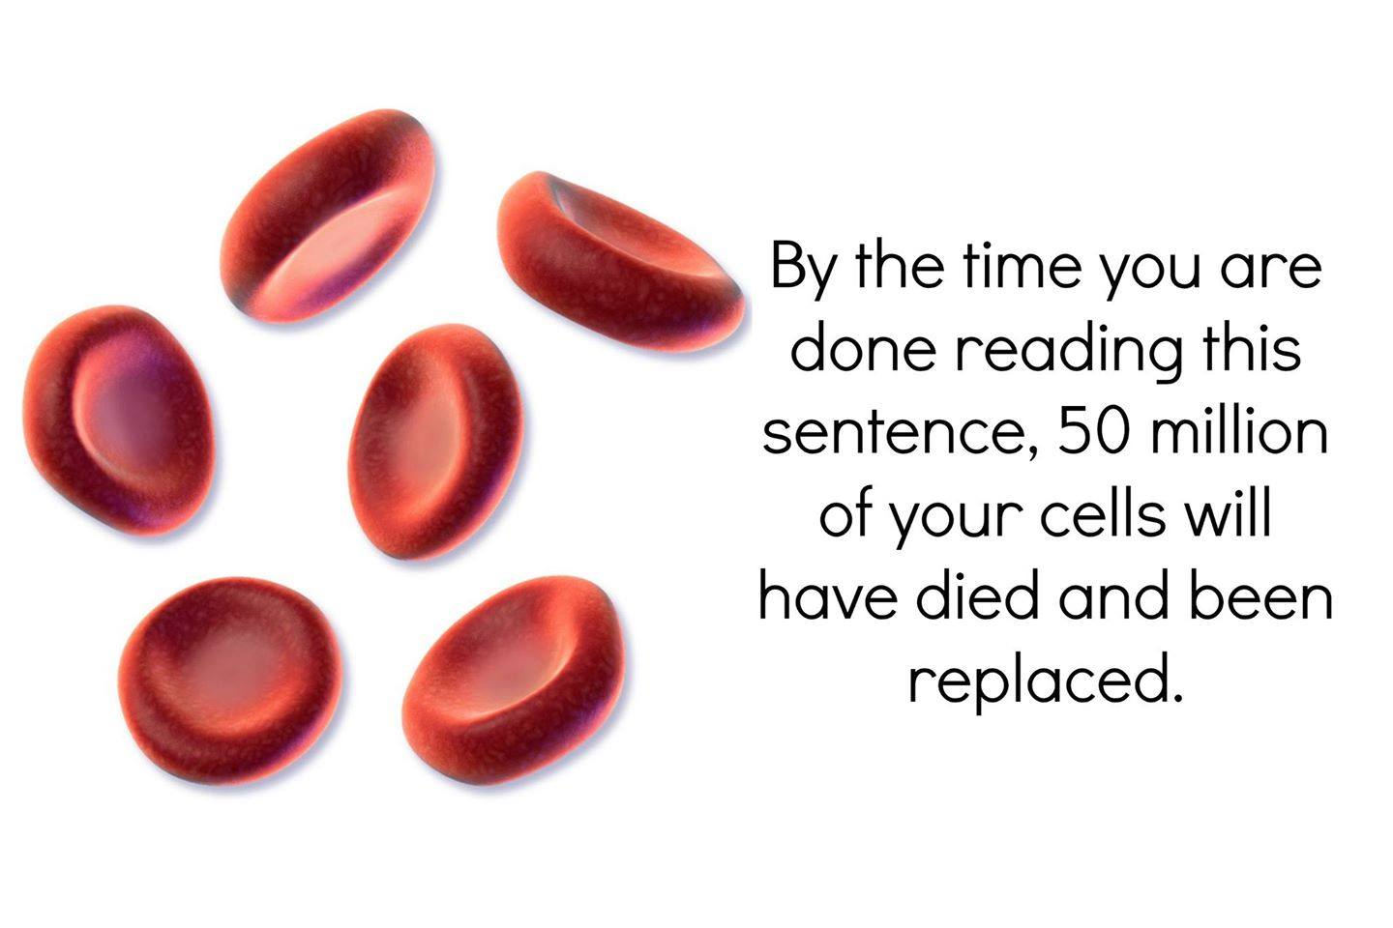
Cell membrane
11 Biology

Slide 2
Subject matter
• Describe the structure of the cell membrane (including protein channels, phospholipids, cholesterol and glycoproteins) based on the fluid mosaic phospholipid bilayer model

Slide 3
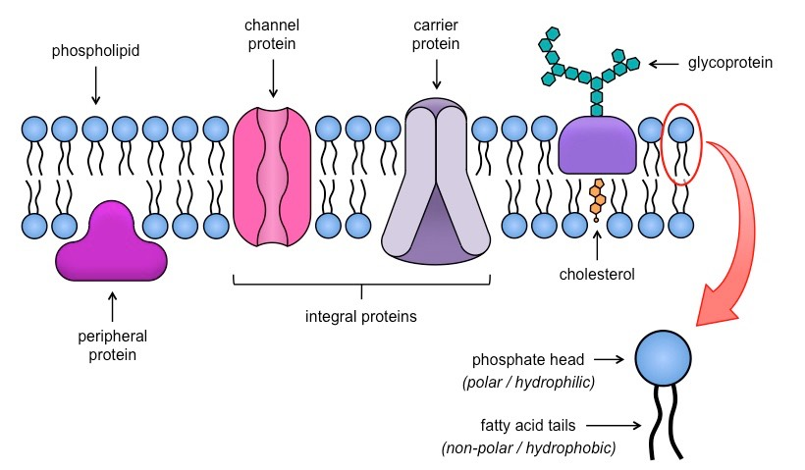
Success criteria
I can describe the structure of the cell membrane (including protein channels, phospholipids, cholesterol and glycoproteins)
I can recall the fluid mosaic phospholipid bilayer model

Slide 4
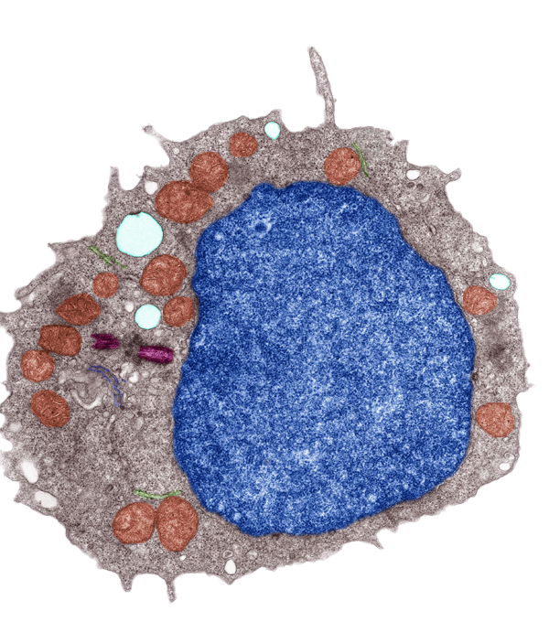
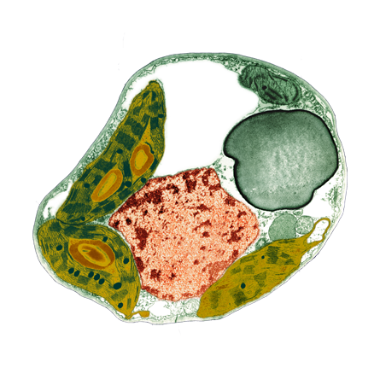
Cell Membrane
Animal cell
The membrane surrounding a cell, called the plasma membrane, forms the boundary that separates the living cell from its non-living surroundings. It is 8nm(0.000008mm) thick.
Selectively controls the movement of materials into and out of the cell
Is responsible for cell-cell recognition (e.g. when cells aggregate into tissues
Is a dynamic structure, with distinct inside and outside faces
Plant cell

Slide 5
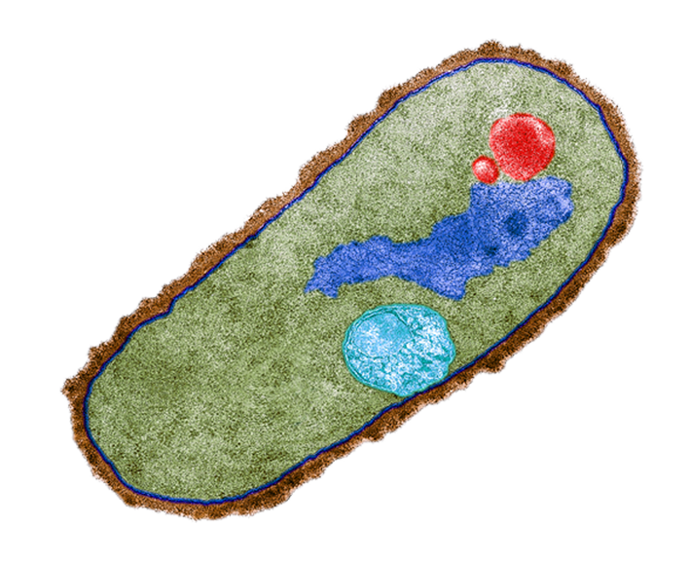
The cell Membrane
A cell membrane, or also called a plasma membrane, is common to all cells.
Bacteria, fungi, and plant cells have a cell wall which lies outside the cell membrane.
Plasma membrane
Cell wall
This colored Bacillus megaterium cell clearly shows the cell membrane, which lies inside the distinct structure of the cell wall.

Slide 7
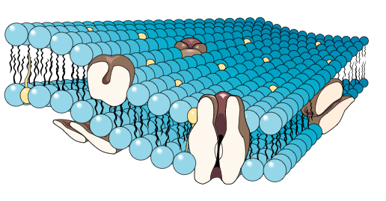

Fluid Mosaic model
The cell membrane is comprised of a double layer of phospholipids (fats) arranged with their hydrophobic tails facing inwards.
The double layer of lipids is quite fluid, with proteins floating within it.
Glycoproteins, glycolipids, and cholesterol are also an integral part of the membrane structure.
Double layer of phospholipids (lipid bilayer)
Hydrophilic end
Hydrophobic end

Slide 8
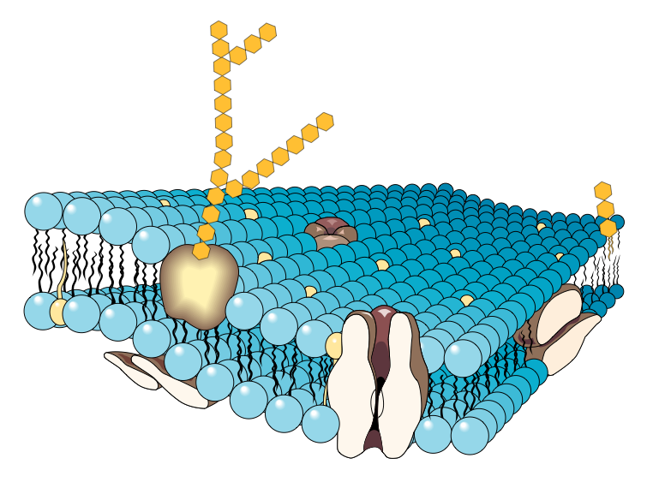
Membrane Structure
Glycoproteins play an important role in cellular recognition and immune responses. They help stabilize the membrane structure.
Glycolipids act as surface receptors and stabilize the membrane.
Some proteins, called peripheral proteins, are stuck to the surface of the membrane.
Some proteins completely penetrate the phospholipid layer. These proteins may control the movement of specific molecules into and out of the cell.

Slide 9
Membrane Structure
Glycolipids also have a role in helping cells to aggregate in the formation of tissues.
Cholesterol in the membrane disturbs the close packing of the phospholipids and keeps the membrane more fluid.
Some substances, particularly ions and carbohydrates, are transported across the membrane via the proteins.

Slide 10
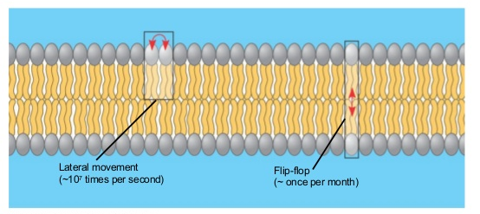
Movement – fluidity
Most of the lipids can move laterally (within the row they are part of in the membrane).
Rare for a molecule to flip across the membrane to the other side (as they would need to pass through the hydrophobic core).
Some proteins can move laterally also.
Proteins are larger, so those that move,
move much more slowly than lipids.
Many are immobile.

Slide 11
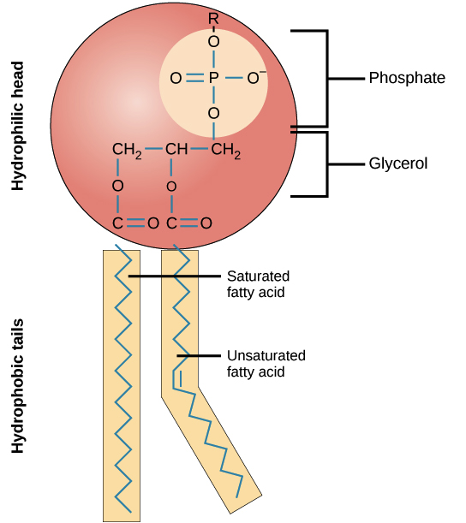
Parts of the membrane phospholipids
Phospholipids, arranged in a bilayer, make up the basic fabric of the plasma membrane. They are well-suited for this role because they are amphipathic, meaning that they have both hydrophilic and hydrophobic regions.

Slide 12
Phospholipids and cell membrane structure
The hydrophilic, or “water-loving,” portion of a phospholipid is its head, which contains a negatively charged phosphate group as well as an additional small group, which may also or be charged or polar. The hydrophilic heads of phospholipids in a membrane bilayer face outward, contacting the aqueous (watery) fluid both inside and outside the cell. Since water is a polar molecule, it readily forms electrostatic (charge-based) interactions with the phospholipid heads.
The hydrophobic, or “water-fearing,” part of a phospholipid consists of its long, nonpolar fatty acid tails. The fatty acid tails can easily interact with other nonpolar molecules, but they interact poorly with water. Because of this, it’s more energetically favorable for the phospholipids to tuck their fatty acid tails away in the interior of the membrane, where they are shielded from the surrounding water. The phospholipid bilayer formed by these interactions makes a good barrier between the interior and exterior of the cell, because water and other polar or charged substances cannot easily cross the hydrophobic core of the membrane.

Slide 13
Parts of the membrane Cholesterol
Cholesterol in the membrane disturbs the close packing of the phospholipids and keeps the membrane more fluid.
Without cholesterol, cell membranes would be too fluid, not firm enough, and too permeable to some molecules. In other words, it keeps the membrane from turning to mush.
Cholesterol is an amphipathic molecule, meaning, like phospholipids, it contains a hydrophilic and a hydrophobic portion. Cholesterol's hydroxyl (OH) group aligns with the phosphate heads of the phospholipids. The remaining portion of it tucks into the fatty acid portion of the membrane.

Slide 14
Cholesterol cont….
Because of the way cholesterol is shaped, part of the steroid ring (the four hydrocarbon rings in between the hydroxyl group and the hydrocarbon "tail") is closely attracted to part of the fatty acid chain on the nearest phospholipid. This helps slightly immobilize the outer surface of the membrane and make it less soluble to very small water-soluble molecules that could otherwise pass through more easily.
Acts as a temperature “buffer” to aid in resisting changes to fluidity
-Below 37 degrees it makes the membrane less fluid by restraining phospholipids movement
-It also lowers the temperature at which the membrane solidifies

Slide 15
Parts of the Membrane carbohydrates
Membrane carbohydrates are usually short, branched chains of fewer than 15 sugar units.
Some bonded with lipids form glycolipids (glyco – refers to carbohydrate).
Cells recognise each other by binding to surface molecules, often to carbohydrates attached to the plasma membrane.

Slide 16
Parts of the membrane proteins
Main part of the mosaic - more than 50 kinds of proteins have been found in the plasma membrane of red blood cells.
Two main types:
Integral proteins – go into the hydrophobic core. Have both polar and non-polar regions.
Peripheral proteins – not embedded in the lipid bilayer, present on inside and outside face of membrane, loosely bound to the surface of the membrane, often exposed to parts of integral proteins.

Slide 17
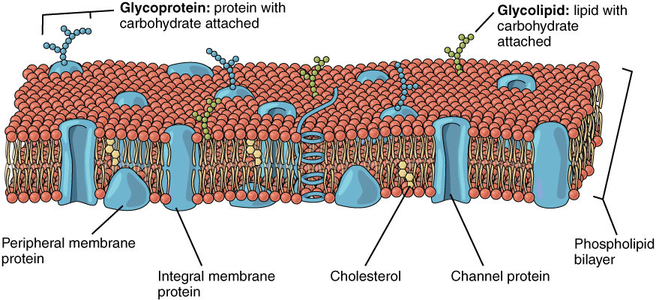

Slide 18
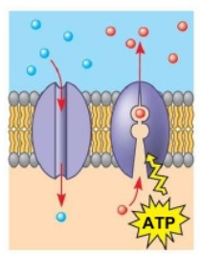
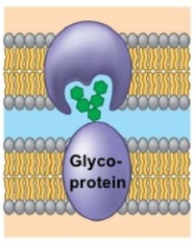
Parts of the membrane proteins
6 major functions are performed by proteins of the plasma membrane:
Transport:
Spans the entire membrane
Provides a channel across the membrane for a particular solute (dissolved substance)
Some change shape from one side of the protein to the other (using ATP as a an energy source to actively pump)
Cell-cell recognition:
Some glycoproteins serve as identification tags that allow other cell’s proteins to recognise that cell

Slide 19
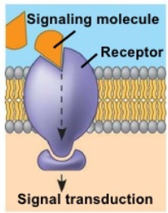
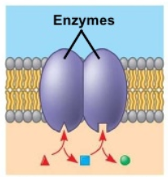
Parts of the membrane proteins
Signal transduction:
A membrane protein (receptor) may have a binding site with a specific shape that fits the shape of a chemical messenger (such as a hormone)
An external messenger (signalling molecule) may cause a shape change in the protein that relays the message to the inside of the cell
Enzymatic activity:
Some enzymes (type of protein) are built into the membrane
Enzymes change the rate of reaction

Slide 20
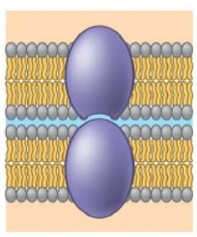
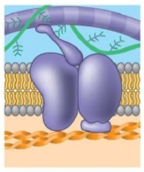
Parts of the membrane proteins
Intercellular joining:
Membrane proteins of adjacent cells may hook together in various kinds of junctions.
Attachment to the cytoskeleton and extracellular matrix (ECM):
Some parts of microfilaments of the cytoskeleton may be bonded to membrane proteins.
Helps with cell shape and stabilise the location of certain proteins.
Proteins that bind to the ECM can coordinate extracellular and intercellular changes.

Slide 21
Videos
Only watch if time – students can watch at home instead really!
Hank - 11 mins
TED – 5 mins
Good quick overview ☺

